Slide 1

Govt. Polytechnic,Manesar
“EARTHING”
Presented By,
Dharam Pal Sr. Lecturer
Branch : ELECTRICAL ENGINEERING

Slide 2
Earthing

Slide 3
Content of topic
Concept of Earthing Systems
What Is Earthing ?
Purpose of Earthing
Methods of Earthing

Slide 4
Concept of Earthing Systems
All the people living or working in residential, commercial and industrial installations, particularly the operators and personnel who are in close operation and contact with electrical systems and machineries, should essentially be protected against possible electrification. To achieve this protection, earthing system of an installation is defined,
designed and installed according to the standard requirements..

Slide 5
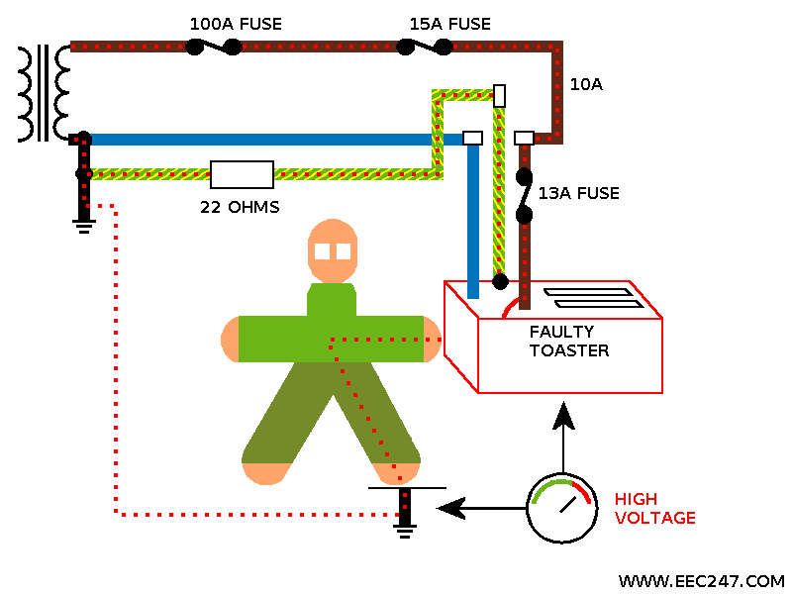
What Is Earthing
The process of connecting metallic bodies of all the electrical apparatus and equipment to huge mass of earth by a wire having negligible resistance is called Earthing.

Slide 6
Purpose of Earthing
To save human life from danger of electrical shock or death by blowing a fuse i.e. To provide an alternative path for the fault current to flow so that it will not endanger the user
To protect buildings, machinery & appliances under fault conditions ie. To ensure that all exposed conductive parts do not reach a dangerous potential.
To provide safe path to dissipate lightning and short circuit currents.
To provide stable platform for operation of sensitive electronic equipments i.e. To maintain the voltage at any part of an electrical system at a known value so as to prevent over current or excessive voltage on the appliances or equipment .
To provide protection against static electricity from friction

Slide 7
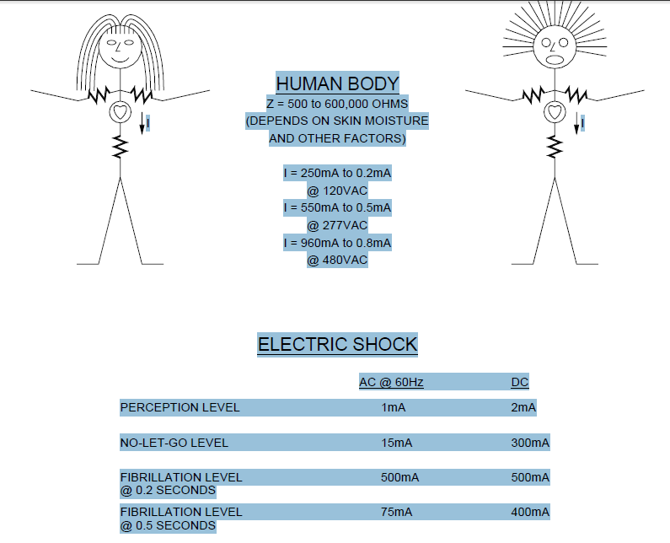
Electric shock
When a high voltage such as 13,800V is involved the body is literally cooked and at times explodes

Slide 8

Methods of Earthing
Plate Earthing
Pipe Earthing
Rod Earthing
Strip Earthing
Earthing through Water Mains

Slide 9
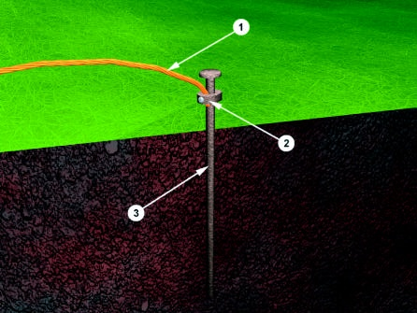
Earthing Electrode
The resistance of a ground
electrode has 3 basic
components:
A) The resistance of the ground
electrode itself and the connections
to the electrode.
B) The contact resistance of the
surrounding earth to the electrode.
C) The resistance of the surrounding
body of earth around the ground
Electrode. It consist of three basic components:
Earth Wire
Connector
Electrode

Slide 10
(1)Plate Earthing
In this type of earthing plate either of copper or of G.I. is buried into the ground at a depth of not less than 3 meter from the ground level.
The earth plate is embedded in alternative layer of coke and salts for a minimum thickness of about 15cm.
The earth wire(copper wire for copper plate earthing and G.I. wire for G.I. plate earthing) is securely bolted to an earth plate with the help of bolt nut and washer made of copper, in case of copper plate earthing and of G.I. in case of G.I. plate earthing.

Slide 11
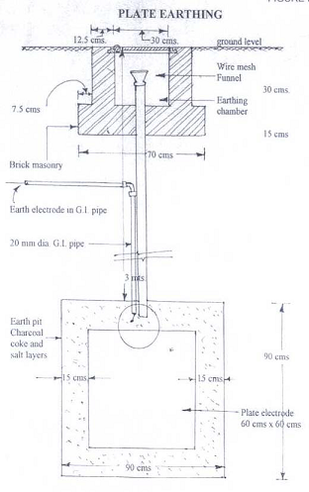
PLATE EARTHING

Slide 12
(2)Pipe earthing
Pipe earthing is best form of earthing and it is cheap also in this system of earthing a GI pipe of 38 mm dia and 2meters length is embedded vertically in ground to work as earth electrod but the depth depend upon the soil conditions, there is no hard and fast rule for this.
But the wire is embedded upto the wet soil.
The earth wire are fastened to the top section of the pipe with nut and bolts.
The pit area arround the GI pipe filled with salt and coal mixture for improving the soil conditions and efficiency of the earthing system.
It can take heavy leakage current for the same electrode size in comparison to plate earthing.
The earth wire connection with GI pipes being above the ground level can be checked for carrying out continuity test as and when desired, while in plate earthing it is difficult.
In summmer season to have an effective earthing three or four bucket of water is put through the funnel for better continuity of earthing.

Slide 13
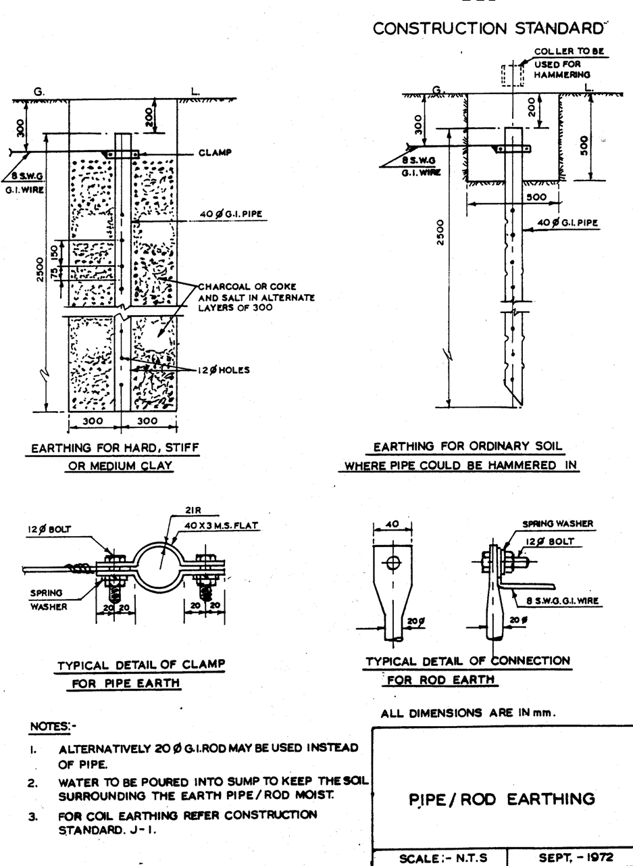
PIPE EARTHING

Slide 14
(3)ROD EARTHING
In this system of earthing 12.5mm diameter solid rods of copper 16mm diameter solid rod of GI or steel or hollow section of 25mm GI pipe of length not less than 3 meters are driven vertically into the earth
In order to increase the embeded length of electrod under the ground, which is some time necessary to reduce the earth resistance to desired value more than one rod section are hammered one above the other.
This system of earthing is suitable for area which are sandy in character .
This system of earthing is very cheap

Slide 15
(4)STRIP OR WIRE EARTHING
In this system of earthing strip electrod of cross section not less than 25mm into 1.6mm of copper or 25mm * 4mm of GI or steel are burried in horizontal trenches of minimum depth of 0.5m
If round conductor are used their cross sectional area shall not be smaller than three if copper is used and 6mm2 if GI or steel is used.
The length of burried conductor shall be sufficient to give the required earth resistance (about 0.5Ωto 1.5Ω)
It shall however be not less than 15 m
The electrod shall be as widely distributed as possible in a single straight or circular trenches radiating from a point
This type of earthing is used in rockey soil earth bed because at such places excavation work for plate earthing is difficult

Slide 16
THANK YOU

